Slide 1
Thank you for being here! Our training session will begin shortly.
Please make sure you are clocked in under your respective cost center (Training-Missouri or Training-Illinois)
If you are currently holding post, you can remain clocked in under your regular cost center.

Slide 2
PTO POLICY
Employee Training
Notes:
Thank you everyone for attending our training session. We are excited to share the enhancements to our PTO Policy and what this means to you as an employee.
Let’s review some housekeeping items before getting started.
We will record the training session today, so participants will be muted until the end of the presentation. Hold your questions until then.
Thank you and lets get started.

Slide 3
OVERVIEW
Policy Review
My Balances
Submit Request
Notifications
Scheduling
What If I Forget?
Notes:
Today we will take a deep dive into the PTO Policy and review the specific changes, and how they will impact our hourly employees.
We will review how employees can look up their balances
The differences between “Available” and “Accruing and Unavailable” hours.
How to properly submit Time Off Requests, whether that be Paid Time Off or Unpaid Time Off
What type of notifications are involved during the process – especially the action steps required by managers.
And what to do if an employee (including yourself) forgets to do this process, so you’re stuck wondering how to correct things after the time has passed.

Slide 4
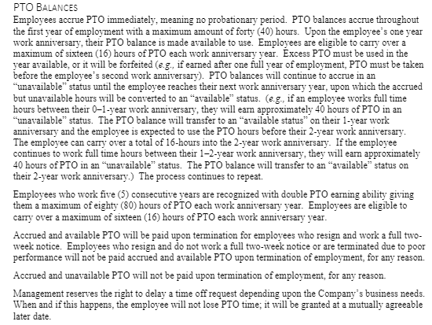
POLICY REVIEW

Slide 5
MY PTO BALANCES
Notes:
Yay! Now we know how the policy works. So, we can start to plan our much-needed time away from work!
Let’s figure out how to view our PTO balances.

Slide 6
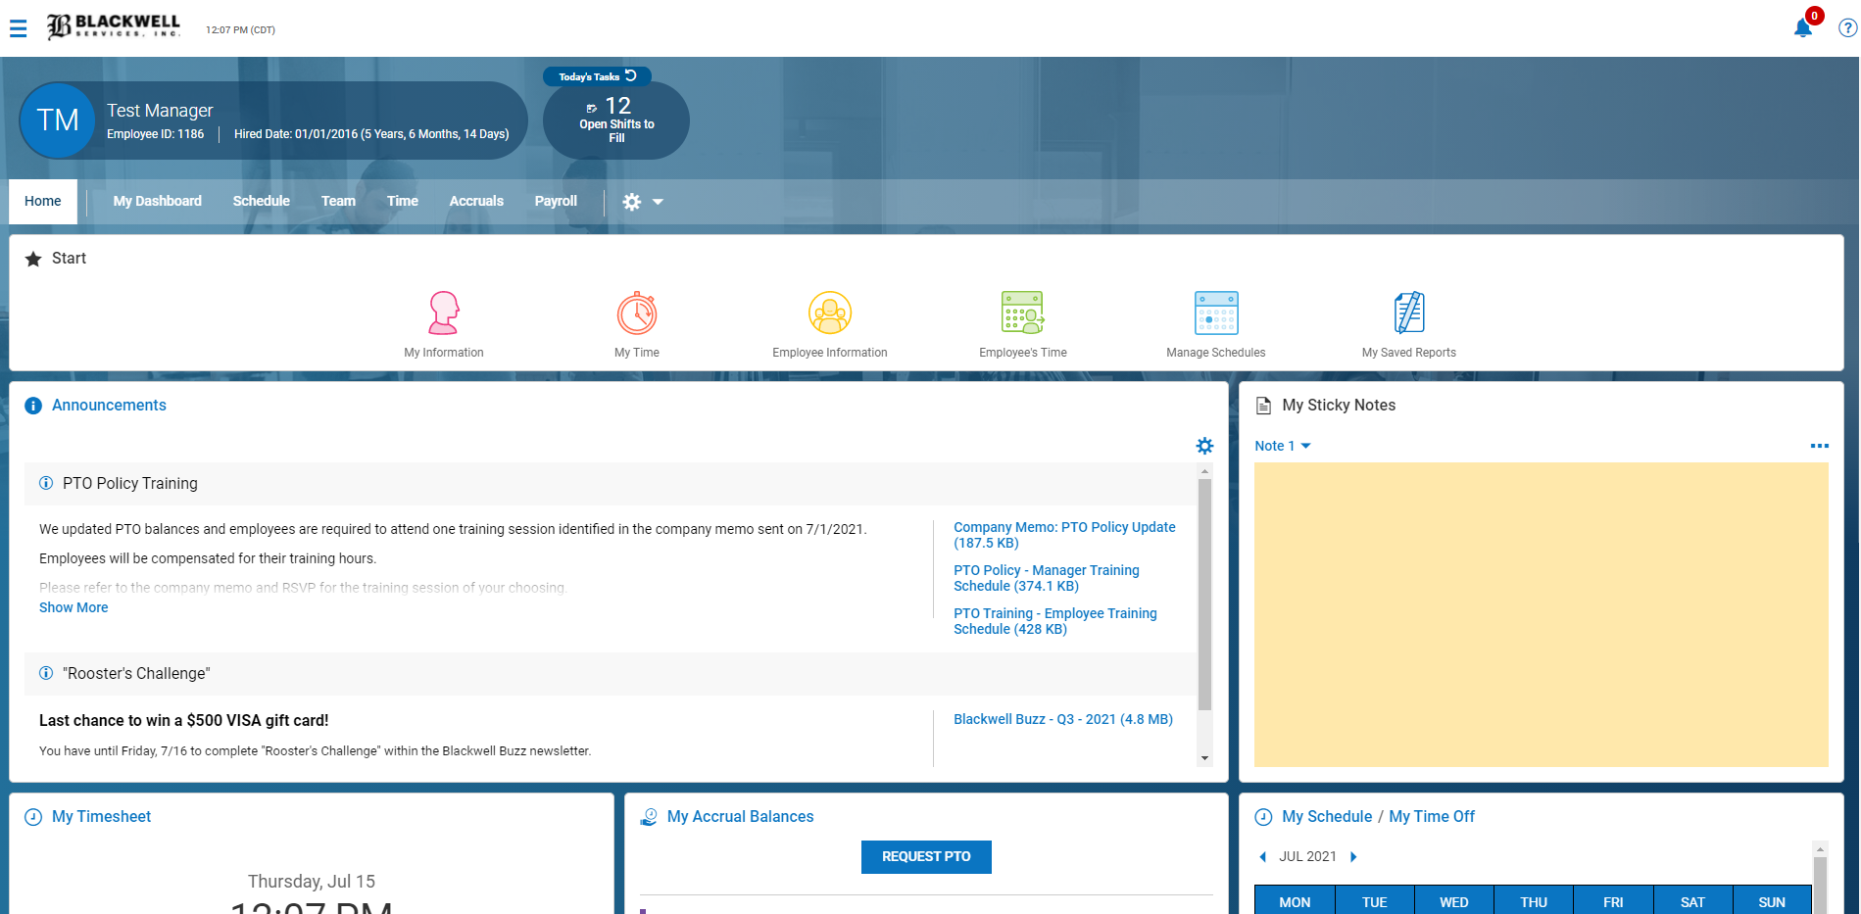
MY BALANCES – Desktop View
Notes:
Employees will log into IPS or HCMToGo.
Scroll down on the page or phone until you see the “My Accrual Balances” widget.
Every employee will have this widget on their dashboard (computer and phone).

Slide 7
HOURLY EMPLOYEES
Hourly employees will see PTO – Hours available and PTO Accruing – Not available
Balances are updated each pay period based on your timecard hours
Each work anniversary, the balances will be moved from “unavailable” to “available”
Employees can carry over up to 16-hours into the next anniversary period.
Notes:
Hourly employees will see two buckets
PTO Hours Available and
PTO Accruing – Not Available. – let take a moment to point out that “hours available” will still show up beside the balance. Unfortunately, we cannot change that wording. The alternative was to remove this bucket from employee’s view…but we didn’t want to do that. So just be mindful of that.
Employees will begin to accrue time off in the “PTO Accruing – Not Available” bucket from their first day on the job. Those hours will accumulate with a ceiling of 40-hours. On their one-year work anniversary, the balance will be transferred into the “PTO Hours Available” bucket.
They have until their next work anniversary to use the hours.
Hours should be used to cover time away on shifts they normally work. We do not “cash out” PTO.
Exceptions can be made, but they require manager recommendations and owner approval.
The employee will continue to accrue time off in the “PTO Accruing – Not Available’ bucket. The balances will routinely transfer on each work anniversary year.
Employees can carry over 16-hours into the next anniversary period.
Hours that exceed 16 will be forfeited.
Again, exceptions can be made based on manager recommendation and owner approval.

Slide 8
Submit Request
Employees can submit requests for Paid Time Off and Unpaid Time Off.
All schedule requests should go through the IPS system
NO MORE PAPER FORMS. HOORAY!
Employees can only submit requests into the future.

Slide 9
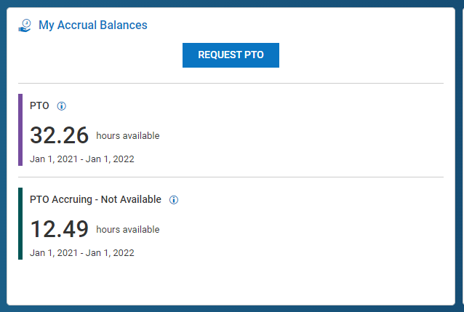
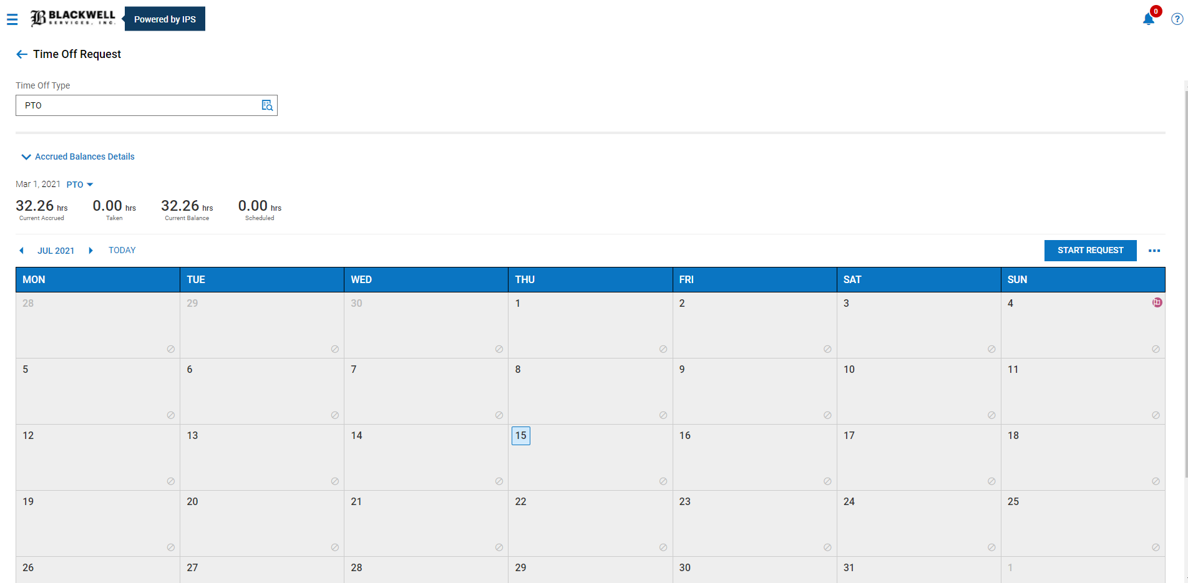
Begin by clicking “Request PTO”
1
Time Off Type defaults to PTO.
If you want to take Unpaid Time Off, click the magnifying glass and change the type.
2

Slide 10
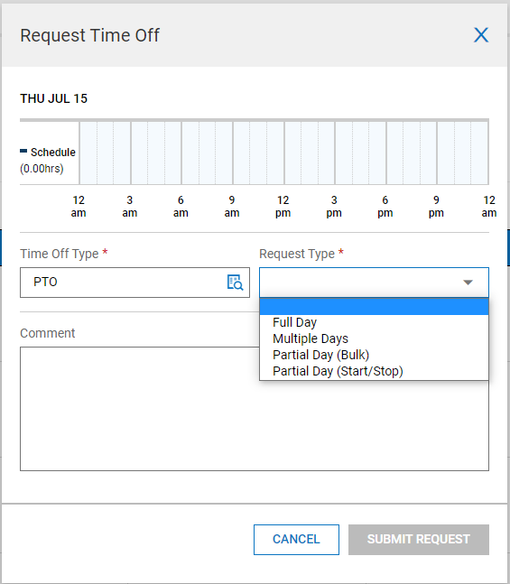
3
4
Select the “Request Type”
Full Day = 1 day off, 8-hour shift
Multiple Days = more than 1 day off
Partial Day (Start/Stop) = time off in the middle of a work shift
5
Employee adds comments.
“Family Reunion in Texas!”
6
Click “Submit Request”.

Slide 11
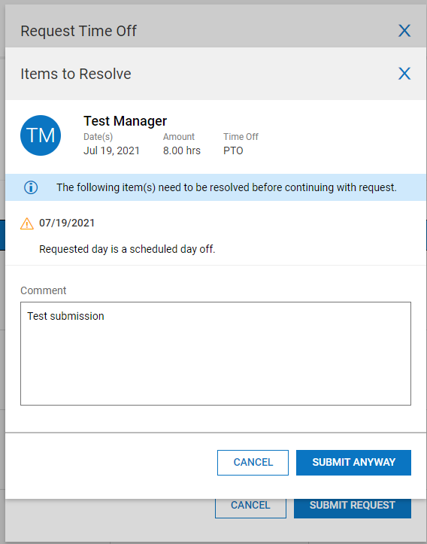
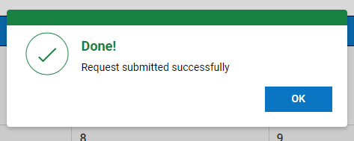
If a work schedule has not been published yet, the employee will receive this alert.
Employee should “Submit Anyway”.
7

Slide 12
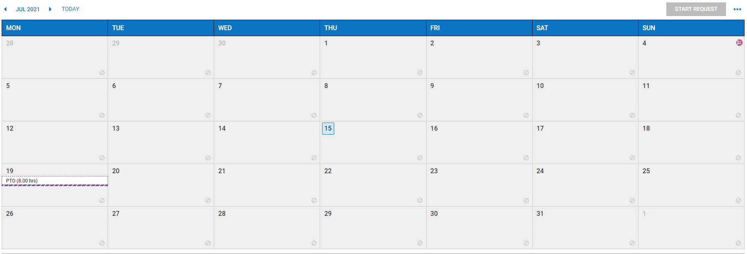
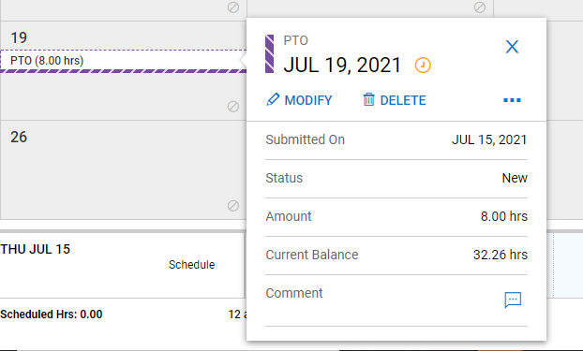
The purple dashed ribbon indicates the request was submitted and pending Manager approval.

Slide 13
NOTIFICATIONS

Slide 15
Account Manager/Lead/Site Supervisor
Receive notification immediately
Territory Manager
Receive notification
HR Department
Receive notification
5-days to decision
5-days to decision
Mandatory decision

Slide 16
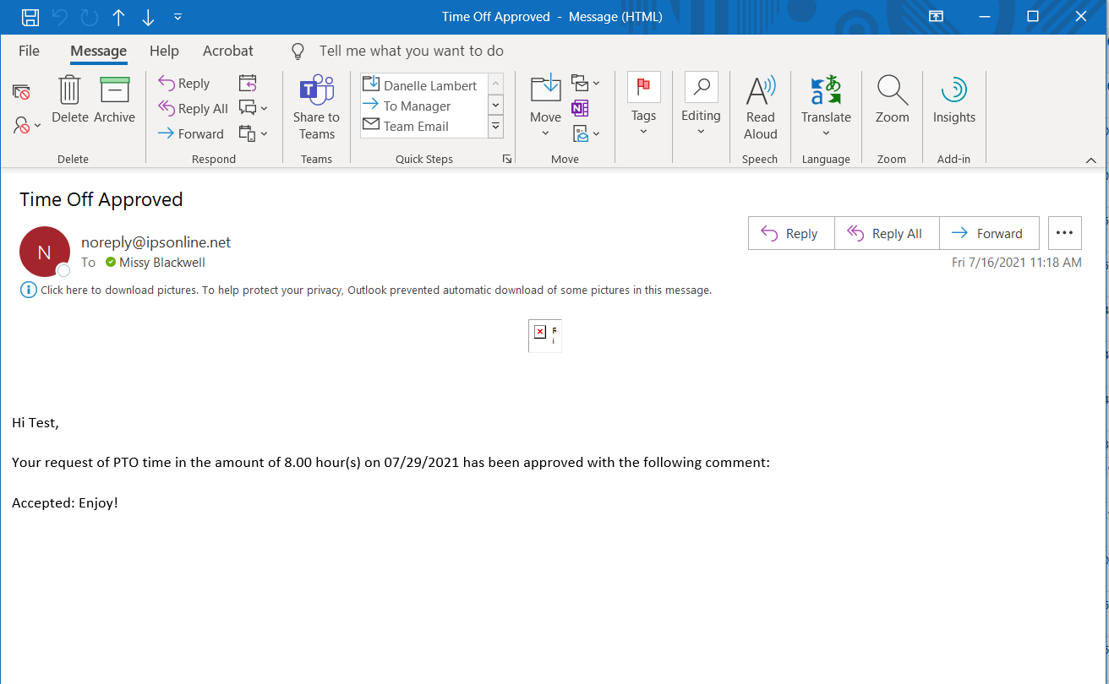
Employee Response Notification

Slide 17
APPROVED PTO ON SCHEDULE
The solid purple ribbon indicates the request is approved.

Slide 19
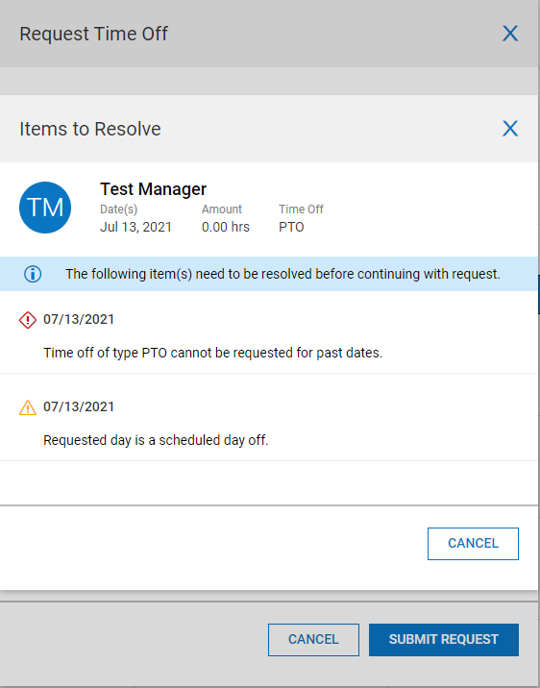
PAST TENSE REQUEST

Slide 20
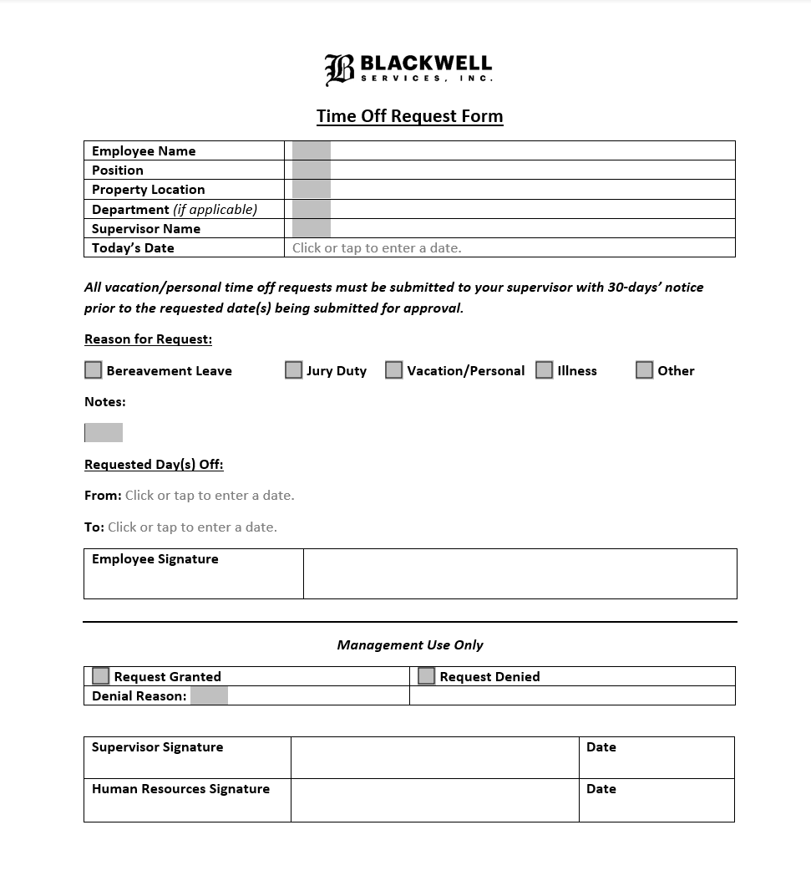
PAST TENSE REQUEST REQUIRES FORM
Signed form submitted to HR Dept.
HR@blackwellinc.com
Recorded in Employee’s File
Notes:
Form requires signatures. Will be rejected by payroll department.
Document can be signed with a wet or electronic signature.

